Slide 1
Lecture 6

Slide 2
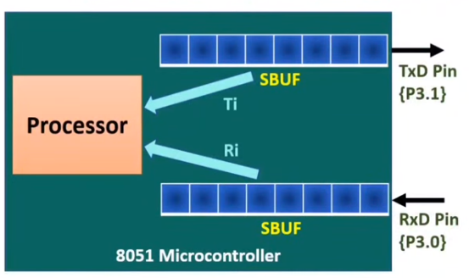
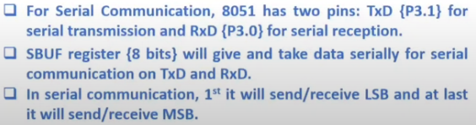

Serial Communication

Slide 3
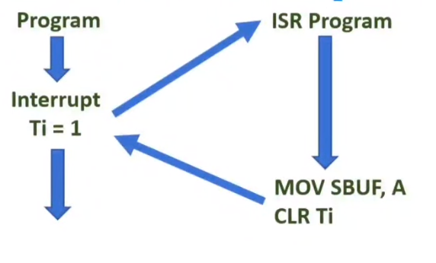
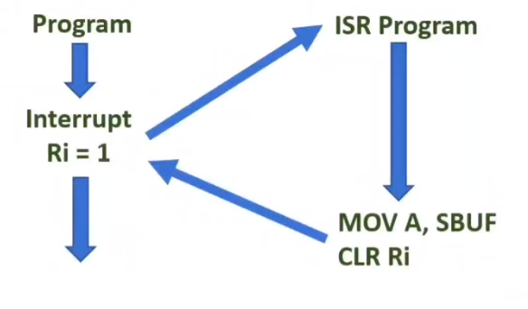

Serial Communication

Slide 4

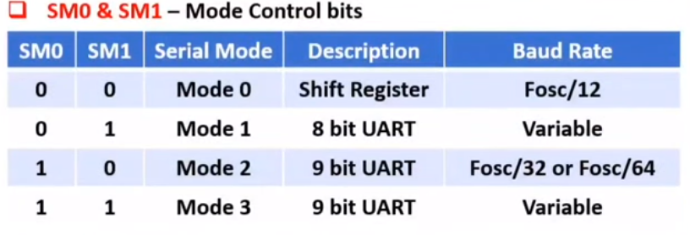
SCON registers

Slide 5
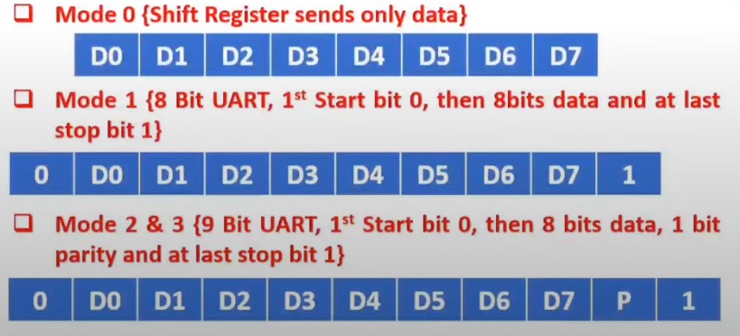
SCON registers

Slide 6
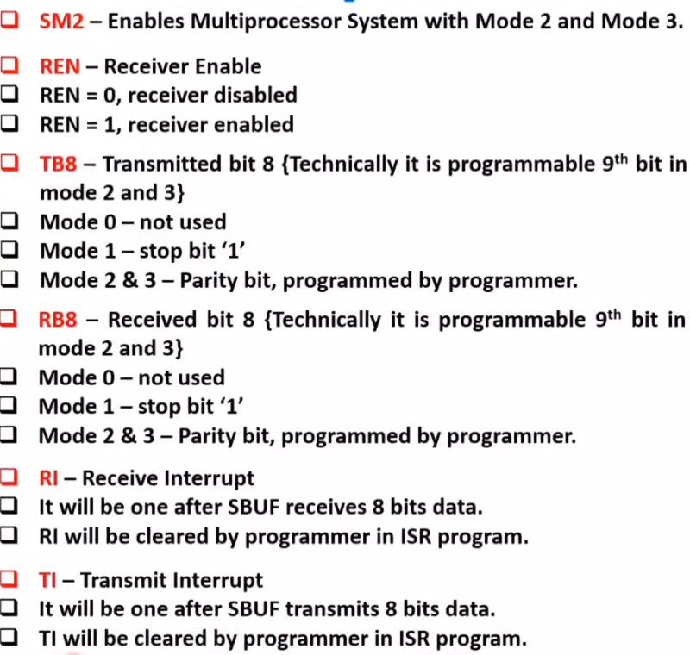
SCON registers

Slide 7
SCON registers

Slide 8

Basics of Interrupts

Slide 9
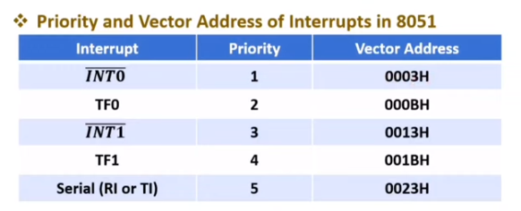
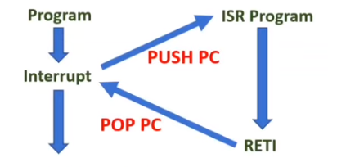
Basics of Interrupts

Slide 10
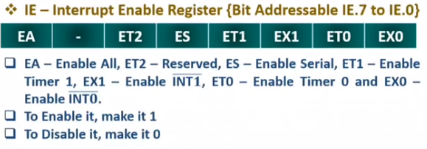
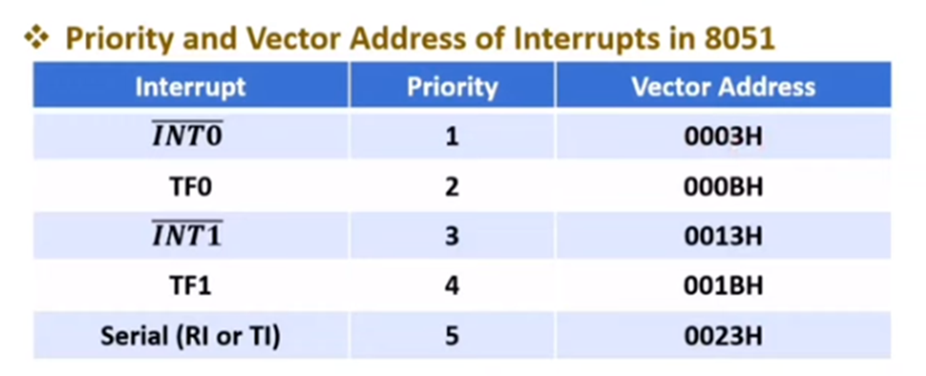
IE registers

Slide 11

IP registers

Slide 12
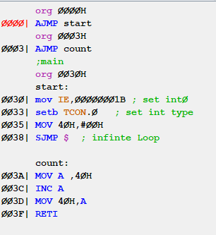
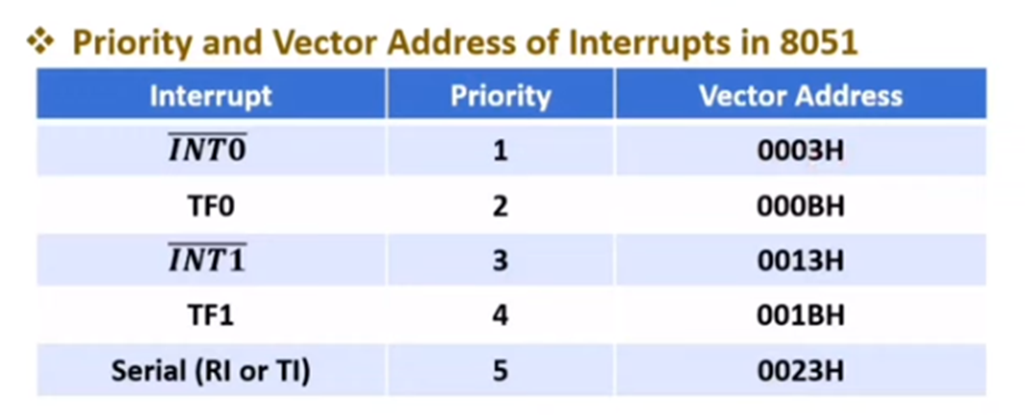
ISR programming

Slide 13

Interrupts 8051 microcontroller Vector Table

Slide 14

Power Saving Modes

Slide 15

Power Saving Modes

Slide 16
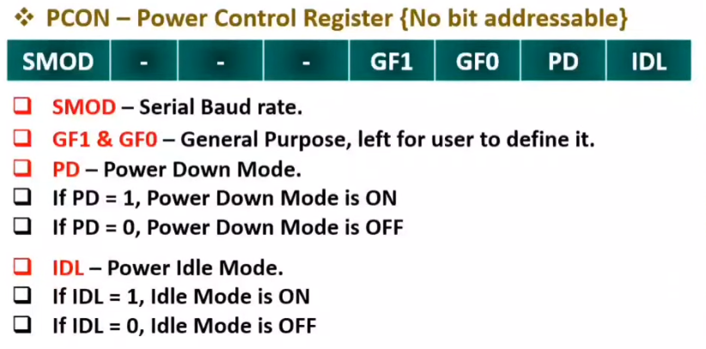
PCON register

Slide 17
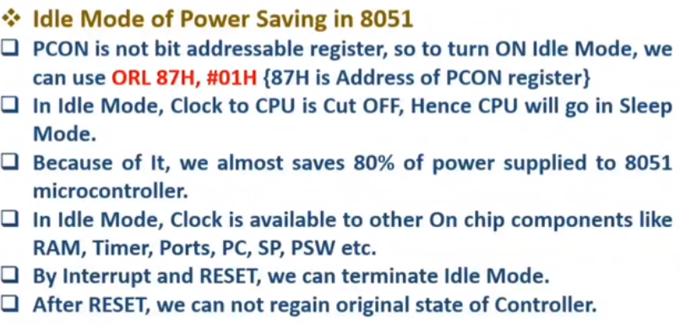
Idle Mode

Slide 18
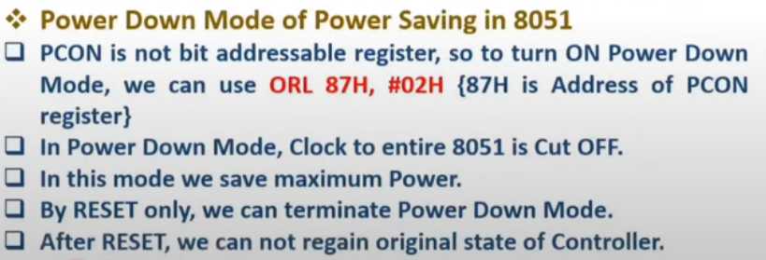
Power Down Mode

Slide 19
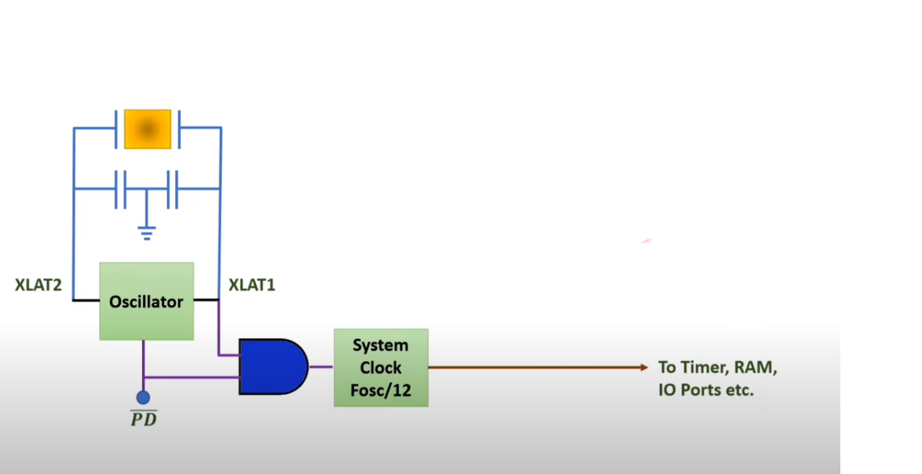
Power Down Mode Circuit

Slide 20
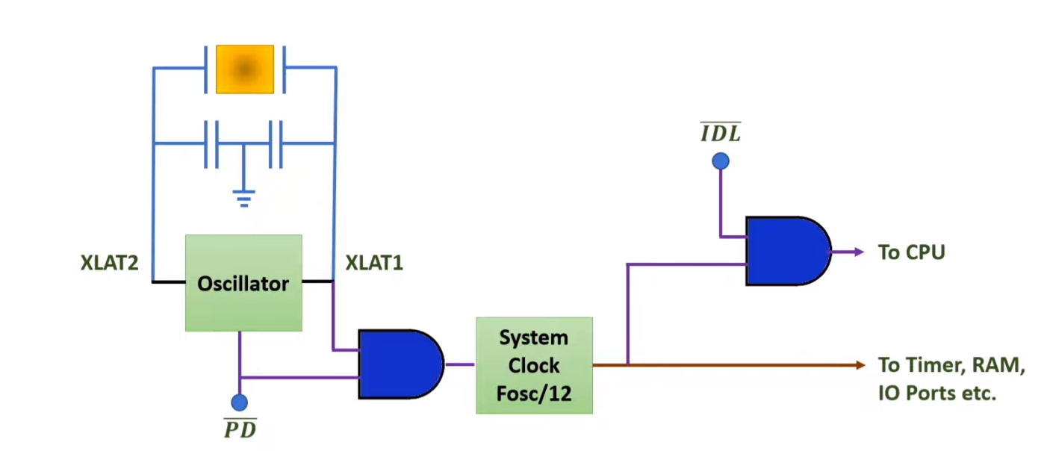
Idle Mode Circuit

